Slide 1
SUMMER TERM – IIT H
DC – AC conversion : Inverter topologies
Analysis of various types of inverters using MATLAB Simulink
Pole phase modulation
Simulation of 3 phase & 9 phase Induction motors in ANSYS

Slide 2
Introduction
There are 2 types of power transfer : Alternating and Direct currents, i.e., AC & DC.
We have Rectifiers to convert from 3 phase AC to DC.
Similarly, we have Inverters to convert from DC to 3 phase AC.
Also, DC to DC conversion is employed using a Buck-Boost converter, in which we can alter the DC voltage magnitude (increase/decrease).
Furthermore, we have AC to AC conversion taken care by a Transformer, which can alter the peak-peak voltage of the AC voltage (increase/decrease), but not altering its frequency.
Our discussion is about DC to AC conversion and hence we are going to discuss about inverters.

Slide 3
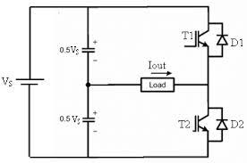
SINGLE PHASE HALF BRIDGE INVERTERS
The switches T₁&T₂ are complementary, so voltage across node a and pole O will be,
V_{ao} = +V_{DC} /2 T₁=1, T₂=0
-V_{DC} /2 T₁=0, T₂=1
Advantages with this configuration:
No DC offset in output.
When connected to an RL load, the output currents are approximately sinusoidal, due to filtering effect due to RL circuit.
Drawbacks with this configuration are:
Contains harmonics of lower order in with magnitudes comparable to the fundamental component. High THD%
Low DC bus Utilization ~ 45%
No control over fundamental component of output voltage.

Slide 4
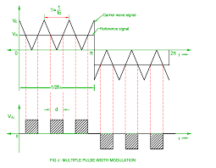
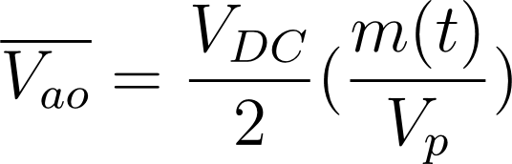
CONTROL SIGNAL IMPLEMENTATION - PWM
The modulating wave m(t) and the carrier wave c(t), are the 2 signals which are compared using a comparator and we implement logic HIGH, when m(t) > c(t) and LOW otherwise.
m = V_{m}/V_{p} (modulating index)
Where V_{m} & V_{p} are the amplitudes of the modulating and the carrier wave respectively.
So, Average Component of voltage of Single Phase Half Bridge Inverters will be,
Where m(t) is the modulating wave and V_{p} is the amplitude of carrier wave.

Slide 5
Major issues with inverter
Inability to control output voltage.
High torque ripple resulted due to current ripple in the load (preferably an induction motor), due to high THD % presence.
Reduced DC bus utilization for a half bridge inverter. Higher DC bus utilization is expected as the bus can be rated for a lower value.
Possible solutions for the these problems are:
We use 2 legs of the switching pole and connect the load between both the poles, also referred to as the H-bridge inverter topology. This topology increases the DC bus utilization to 90%.
Now, since we have optimised DC bus utilization, let us look at the other issues with this converter.

Slide 6
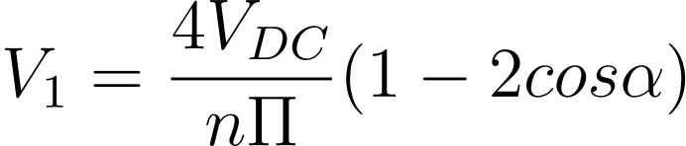
The THD ratio still remains the same, even in the H-bridge inverter.
The control on the fundamental component of the voltage is still not established.
So, we employ another switching scheme to gain control over the fundamental component of the voltage and also reducing harmonics of lower order.
Switching angles in PWM
By retaining the Odd nature of the output voltage, Half wave symmetry and quarter wave symmetry, we provide switching signal one or multiple times per quarter in order to establish the required control.
When we turn on and off the switch for a single instance, then we the output voltage fundamental component will be,
Hence by adjusting the firing angle α, we can control the output voltage.
Also, by introducing multiple switching operations per quarter, we can eliminate the harmonics in the output voltage also by choosing a certain combination of values of α.

Slide 7
Control over fundamental voltage component
From using Multiple Switchings per quarter, we can control the output fundamental using the firing angle α.
Elimination of lower order harmonics in output voltage
N switchings per quarter eliminate (N-1) lower order harmonics.
Higher DC bus Utilization
By using a Full bridge inverter instead of the Half bridge/single leg inverter, we can increase the DC bus utilization by 2 times, from ~ 45% to ~90%.
Also, when we use induction motor as a load, the windings are RL load which act as a filter.
Also, Space Vector PWM can be used.

Slide 8
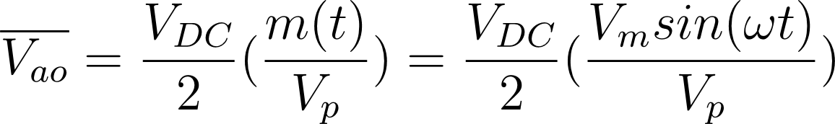
SINE δ^{le} PWM scheme
The modulating wave m(t) is now a sinusoidal wave whereas the carrier wave c(t) remains to be a triangular wave.
By this means, the average of the output voltage produced will be,
For half bridge inverter,
Also, by DFT (Double Fourier Transform), the fundamental component of the output voltage is equal to the average component of the output voltage.
For single phase H-bridge inverter, we have 2 switching schemes: Unipolar & Bipolar.
Unipolar involves generation of 2 switching signals whereas Bipolar requires a single switching signal for all switches.

Slide 9
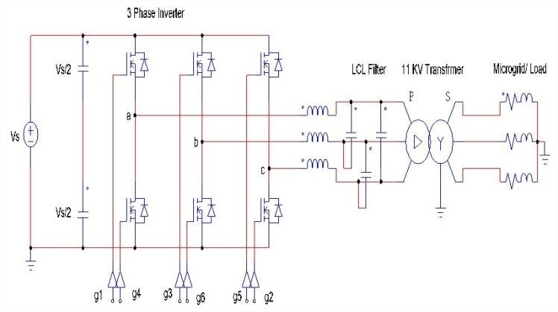
3Φ INVERTER design

Slide 10
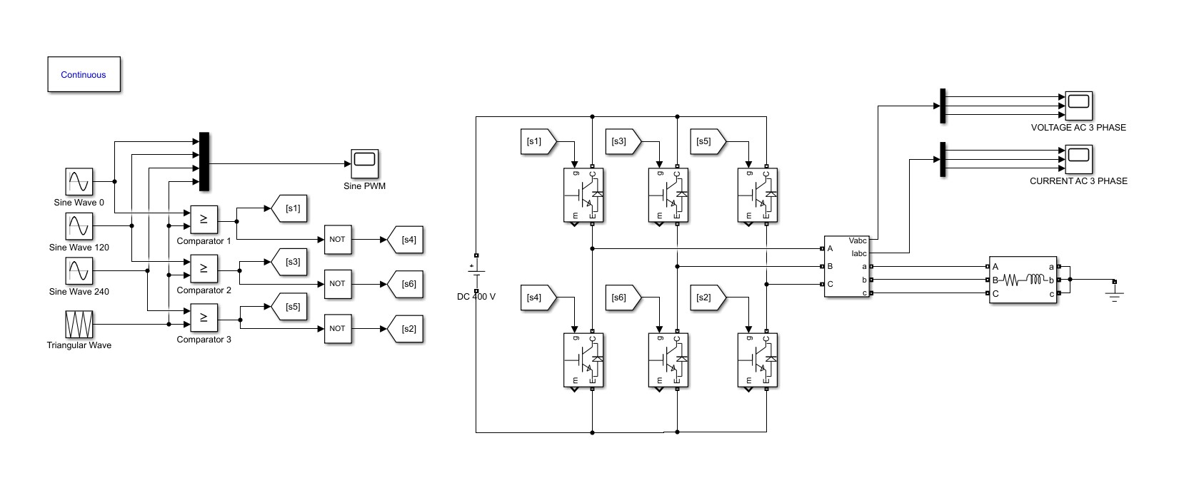
To produce 3 phase output, we generate 3 different switching signals for 3 legs of the inverter. This is done through using the same carrier wave and 3 sinusoidal waves at 120° phase shifted as modulating waves for each leg.
We employ 180° conduction mode for the switches and 120° phase shift for the modulating waves to get the required PWM output.

Slide 11
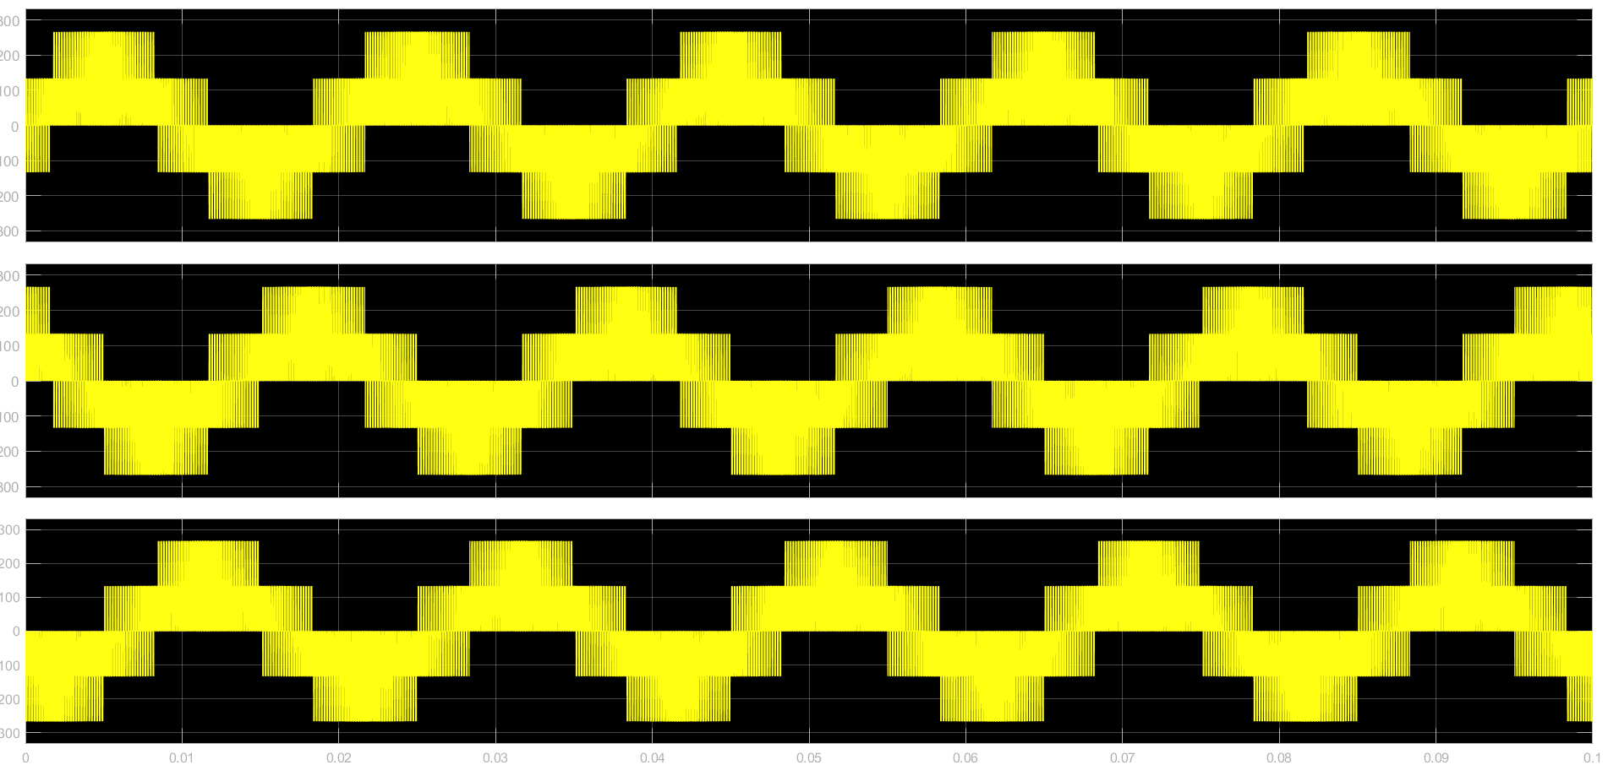
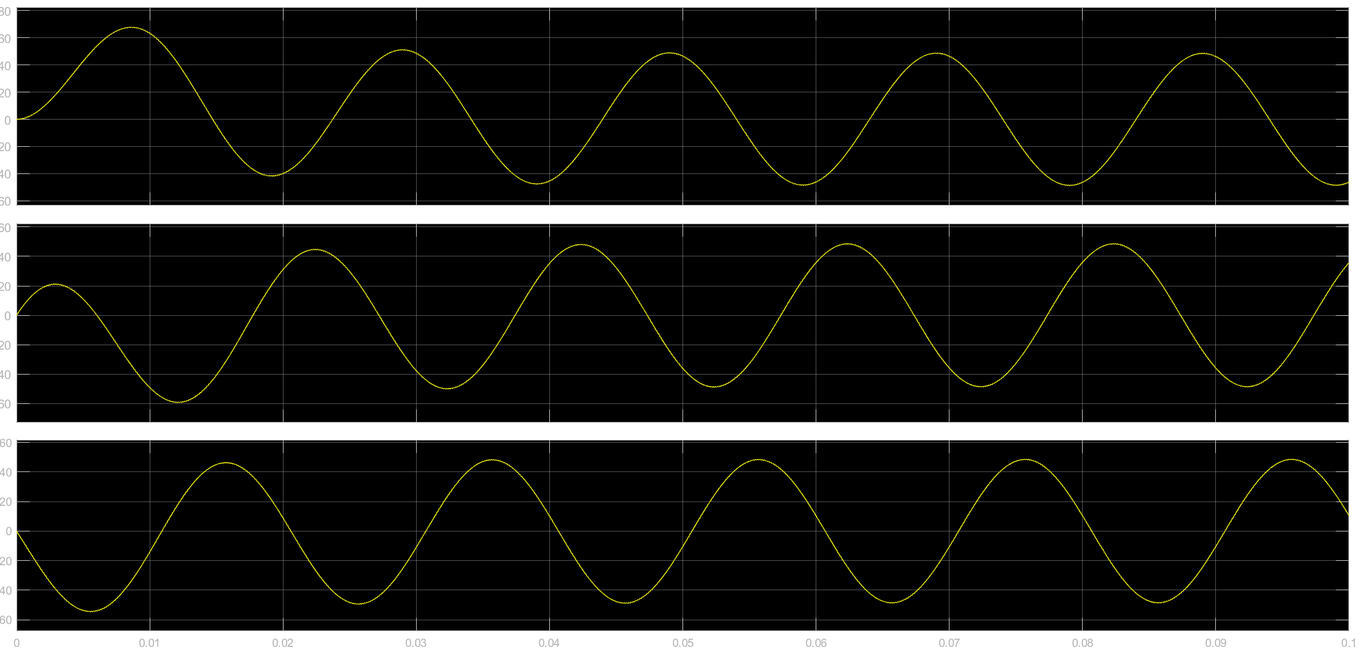
OUTPUTS OF 3Φ INVERTER
The voltage output waveform for a 3Φ inverter circuit.
The current output waveform for a 3Φ inverter circuit for an RL load of 1Ω and 0.01 H

Slide 12
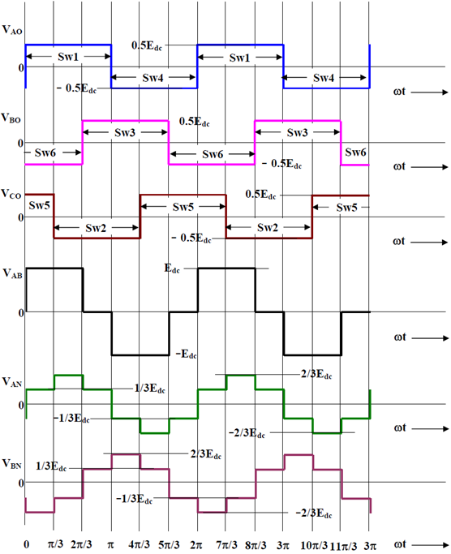
LINE, PHASE AND POLE VOLTAGES OF 3Φ INVERTER
The pole voltages will be similar to that of half bridge inverter and will contain higher order harmonics, whereas the line-line voltages and phase voltages will not contain 3rd order harmonics in them.
Hence, the only (6n ± 1)^{th} order harmonics will be present in line-line voltages and phase voltages, and this results in less ripple in load currents and torque if the load is an induction motor.

Slide 13
MULTILEVEL INVERTERS
Multilevel inverters nowadays are used for medium voltage and high power applications. The different field of applications include its use as UPS, High voltage DC transmission, Variable Frequency Drives, in pumps, conveyors etc.
Different Topologies which function as multilevel inverters are:
Cascaded H-bridge multilevel inverter
Neutral Point Diode Clamped (NPC) inverter
Flying Capacitor Inverter
Advantages of these topologies are:
Reduced harmonic distortion and THD%
Higher no. of voltage levels established

Slide 14
MULTILEVEL INVERTER
THD is Low in the output waveform
CONVENTIONAL INVERTER
THD is high in the output waveform
High voltage levels cannot be produced
High dv/dt and EMI
High voltage levels can be produced
Low dv/dt and EMI

Slide 15
MULTILEVEL INVERTERS
Common DC sources
NPC Diode Inverter
Flying Capacitor Inverter
Separate DC sources
Cascaded Inverters

Slide 16
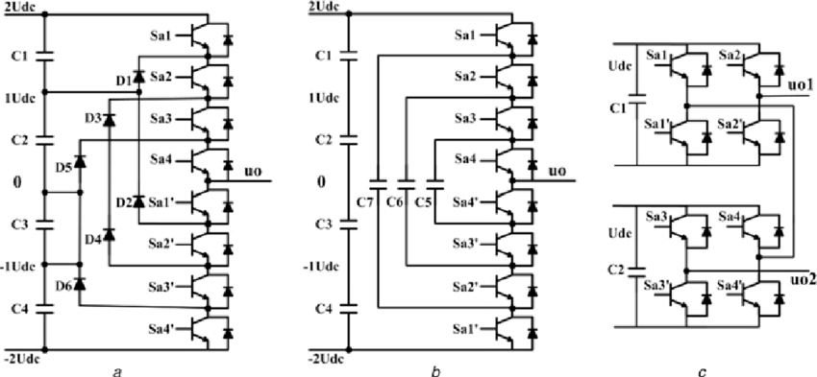
Multilevel inverters Topologies
Different multilevel power converter topologies with related structures
We can produce any number of levels using these topologies but the complexity and the components number increase along with increase in the number of levels.
NPC Diode Inverter
Flying Capacitor Inverter
Cascaded Inverter

Slide 17
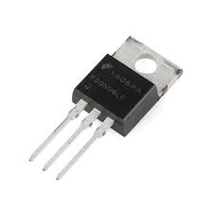
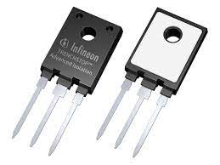
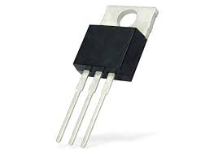
USAGE OF SWITCHES BASED ON POWER LEVEL
< 10 KW rating VSI
MOSFETs :
f_{SW} = 20-100 kHz
> 1 MW rating VSI
Thyristors :
f_{SW} < 1kHz
> 10 KW rating VSI
IGBTs :
f_{SW} = 1-5 kHz

Slide 18
Simulation of induction machines in ANSYS
The steps to be followed while attempting to perform a simulation in ANSYS Electronics Desktop 2020 R2 version are :
Building of a model of machine in RMxprt by giving the machine parameters for machine, stator, rotor, shaft, and creation of setup with relevant parameters and validation and analysis of setup.
Conversion of RMxprt model into MAXWELL 2D model and giving the required excitation currents for observing pole formation using flux lines & magnetic vector plots, torque, speed, currents, voltages, induced voltages, flux linkages for all phases, after validation and analysis.
Changing the excitation currents from 3 phase to 9 phase to observe the similar above-mentioned simulation results.

Slide 19
Brief details about using ANSYS
RMxprt tool lets us define parameters of the machine such Machine, Stator, Rotor, Stator slots, Stator winding, Rotor slots, Rotor windings, Shaft.
We assign the parameters, create a setup, validate the setup and then analyze the setup. Then we can find the details of the motor like Design sheets which contain insights about details like power factor, core losses, resistance and reactance of stator and rotor, rated torque, rated speed of the machine, Performance, Graphs of various variables like torque, speed, slip, efficiency.
Then we proceed to further analysis using the setup and creating a Maxwell 2-D model by using the RMxprt Setup, where we can give input parameters like load torque, moment of inertia of motor, initial speed of the machine, excitations, solver configuration for analysis and get various helpful statistics like the currents, voltages, induced voltages, flux linkages, power, torque and speed in the form of interactive graphs plotted w.r.t time and flux lines and magnetic vectors in the form of vector field diagrams on the machine itself.

Slide 20
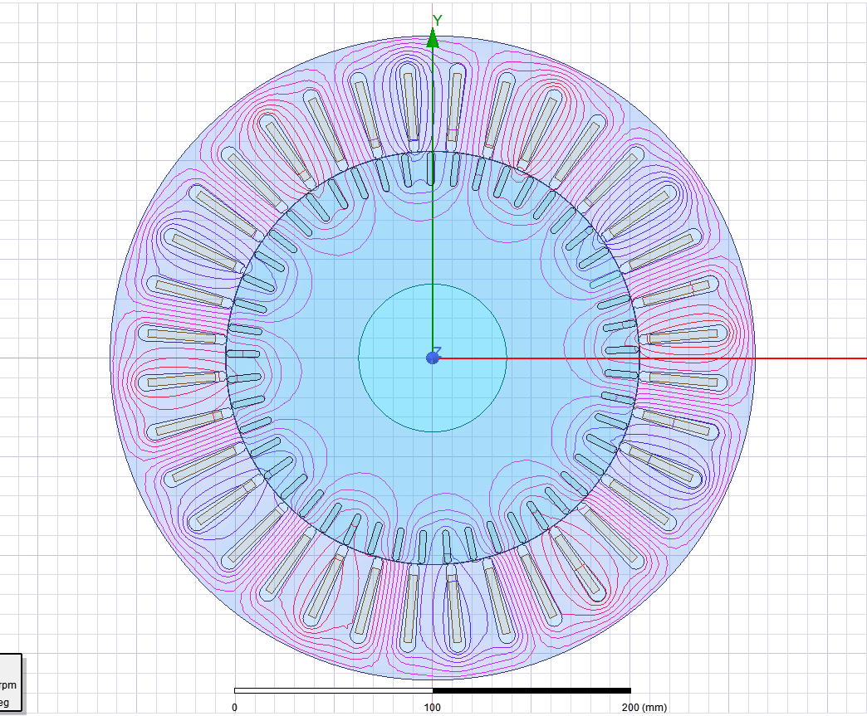
3 phase 12 pole configuration
Input excitation currents are :
Given a voltage of 415 Volts for all the 3 phases, each phase gets about 239.6 V rms per phase.
So, the Voltage waveform equation will be.
V = 338.846 sin(100πt + Φ)
Where Φ is the phase difference which is 0°, 120°, 240° respectively.

Slide 21

9 phase 4 pole configuration
Input excitation currents are :
Given a voltage of 415 Volts for all the 9 phases, each phase gets about 138.33 V rms per phase.
So, the Voltage waveform equation will be.
V = 195.633 sin(100πt + Φ)
Where Φ is the phase difference which is 0°, 40°, 80°, 120°, 160°, 200°, 240°, 280°, 320° respectively.

Slide 22
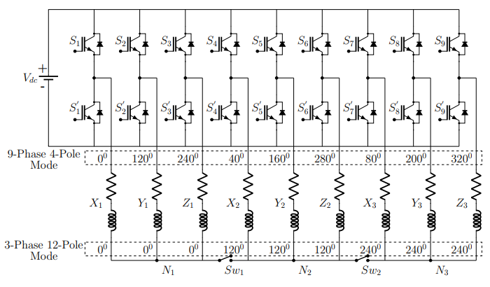
Pole phase modulation
We use pole phase modulation to while operating an induction motor with an inverter for a 9-phase machine and changing the switching schemes accordingly to operate a 36-slot machine into 3 phase 12 pole and 9 phase 4 pole machine, respectively.

Slide 23
Learning outcomes of this internship period
DC-AC power conversion using inverters, Sine PWM techniques.
Exposure to Multi level inverters – NPC, Flyback capacitor, Cascaded H-bridge.
Machine design for multiphase induction machines.
Good understanding of MATLAB Simulink for simulation of various configurations of inverter & ANSYS Electronics software for simulation of multiphase induction machines.
Why should we use Pole phase modulation techniques ?
Answer : It would ideally take a 15-kW machine to produce ~100 N-m of torque and 1500 rpm speed simultaneously, but we achieve this using a 36 slot 5-kW induction motor by pole phase modulation, where ~100 N-m of torque is produced by 3 phase 12 pole configuration and 1500 rpm speed is taken care by the 9 phase 4 pole configuration.

Slide 24
References
A Brief Review on Multi Level Inverter Topologies : https://ieeexplore.ieee.org/document/7530373
Dual-Inverter-Fed Pole-Phase Modulated Nine-Phase Induction Motor Drive With Improved Performance - IEEE Journal by Dr. B. S. Umesh and Dr. K. Sivakumar : https://ieeexplore.ieee.org/document/7463509
SVPWM Control Techniques for Pole-Phase Modulated Nine-Phase Induction Machine Drives for Extended Speed-Torque Range Applications – PhD Thesis by Dr. V Janaki Ramaiah, IIT Hyderabad.
Study and analysis the effect of variable applied voltage on SCIM performances based on FEA – IJPEDS Journal by Waleed Khalid Shakir Al-jubori , Yasir Abdulhafedh Ahmed.
New Five-Level Double-Flying-Capacitor Inverter Fed by a Boost-Flyback Converter – IEEE conference paper by Antonio Venancio de M. Filho, Edison Roberto C. da Silva, André Elias L. da Costa.
Electrical Machine Design – Unit 6 : Design of Induction Motors.
Video Lectures of EE 6230: Modeling and Control of Electric Drives – IIT Hyderabad by Dr. Seshadri Sravan Kumar V.
Induction motor analysis using ANSYS RMXprt Part 1 - https://youtu.be/IYIjDznFO6o
Induction motor analysis using ANSYS RMXprt Part 2 - https://youtu.be/LVj_INgXgUk
Thank You
Miriyala Pranay Kamal
200030033@iitdh.ac.in
EE 2020

